Slide 1



AWS Migration for Café Hosting
Cost Analysis & Benefits Overview
CLOUD MIGRATION
COST OPTIMIZATION
Visit Live Site: cafena.com

Slide 2

Overview
Why Migrate to AWS?
Your café is moving from a local cloud hosting provider with fixed monthly fees to Amazon Web Services. This migration will dramatically reduce costs, improve reliability, and position your business for future growth—all while eliminating the complexity of traditional hosting.
AWS charges only for what you actually use, not for capacity you might need someday.
Visit Live Site: cafena.com

Slide 3

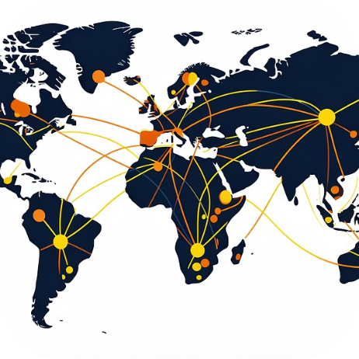

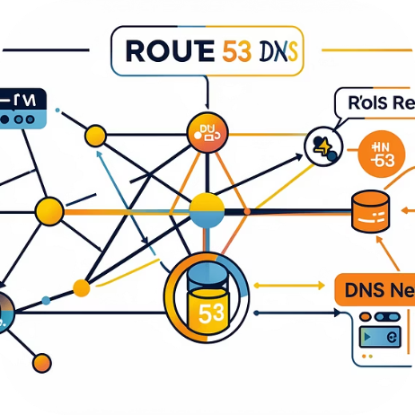
AWS Services Breakdown
The core services powering your café's static website—each designed to replace expensive traditional hosting with smart, scalable alternatives.
Amazon S3
CloudFront CDN
IAM Access Control
Route 53 DNS
Hosts your website files (HTML, CSS, images). Free tier covers 5 GB storage and 20,000 requests monthly—far more than a typical café site needs.
Optional performance boost through global caching. Free tier includes 1 TB transfer and 2 million requests—your café's traffic won't exceed this.
Centralized permission management, always free. Provides fine-grained security controls that replace basic account-level access from local providers.
Custom domain management for $0.50/month if needed. For demos or internal reviews, you can skip this and use the S3 endpoint directly.
Visit Live Site: cafena.com

Slide 4

Monthly Cost Scenarios
What This Means
Even with a full AWS setup including CloudFront and Route 53, your monthly hosting costs stay under $1. The S3-only option—perfectly adequate for most café websites—costs absolutely nothing within the free tier.
As you expand to multiple locations, costs remain minimal unless you add dynamic services or complex office systems.
Visit Live Site: cafena.com

Slide 5
Pricing Model Comparison
Local Cloud Provider
Fixed monthly hosting plan regardless of traffic
Storage and bandwidth caps
Scaling requires expensive plan upgrades
Paying for unused capacity during slow periods
Limited regional redundancy
AWS Pay-As-You-Go
Pay only for actual storage and requests used
No fixed monthly hosting fees
Automatic scaling during traffic spikes
Free tier covers typical café website needs
Global infrastructure with built-in redundancy
The fundamental difference: local providers charge for capacity, AWS charges for consumption. For a café website with modest traffic, this means near-zero hosting costs.
Visit Live Site: cafena.com

Slide 6
On-Premises Reality Check
Why self-hosting your café's website creates hidden costs and technical burdens.
Technical Drawbacks
Upfront Hardware
Monthly Operating Costs
No redundancy—downtime during power outages
Public IP often requires additional ISP fees
Manual security patching and updates
HTTPS configuration complexity
No automatic scaling or disaster recovery
Admin time diverted from café operations
Mini PC/desktop, SSD storage (256 GB), UPS power protection. Significant capital expense before hosting even begins.
24/7 electricity, business internet, router/firewall amortization, maintenance time. Costs are fixed regardless of website traffic.
Visit Live Site: cafena.com

Slide 7
Side-by-Side Comparison
Factor
AWS (S3)
Local Cloud
On-Premises
Monthly Cost
Near $0
Fixed fee
Fixed + operating
Pricing Model
Usage-based
Fixed plan
Capital + maintenance
Scaling
Automatic
Plan upgrades
Manual hardware
HTTPS Setup
Automatic
Varies by provider
Complex configuration
Maintenance
None required
Minimal
High admin time
Disaster Recovery
Built-in
Limited
Manual setup
Visit Live Site: cafena.com

Slide 8
Key Migration Benefits
1
2
3
4
Cost Efficiency
Automatic Scalability
Built-In Reliability
Enterprise Security
Eliminates fixed monthly hosting fees. Converts operational expenses into variable, usage-based spending that scales with your actual needs.
AWS global infrastructure provides high availability, fault tolerance, and automated recovery. Horizontal scaling eliminates single points of failure.
Shared responsibility model: AWS secures infrastructure while you control data and access. IAM, encryption (KMS), Security Hub, and VPC protection included.
Handles seasonal traffic spikes during promotions without manual intervention or plan upgrades. Storage and delivery capacity adjust automatically.
Visit Live Site: cafena.com

Slide 9
AWS Support & Service Quality
What's Included (Free)
Customer Feedback
AWS Basic Support covers everything a café website needs without additional cost.
Users consistently report fast initial responses, thorough issue investigation, proper escalation when needed, and detailed follow-up solutions. For static website hosting, Basic Support is more than sufficient.
Comprehensive documentation and knowledge base access
AWS Health Dashboard for service status monitoring
Billing and account support with clear explanations
Community forums with active AWS experts
Visit Live Site: cafena.com

Slide 10
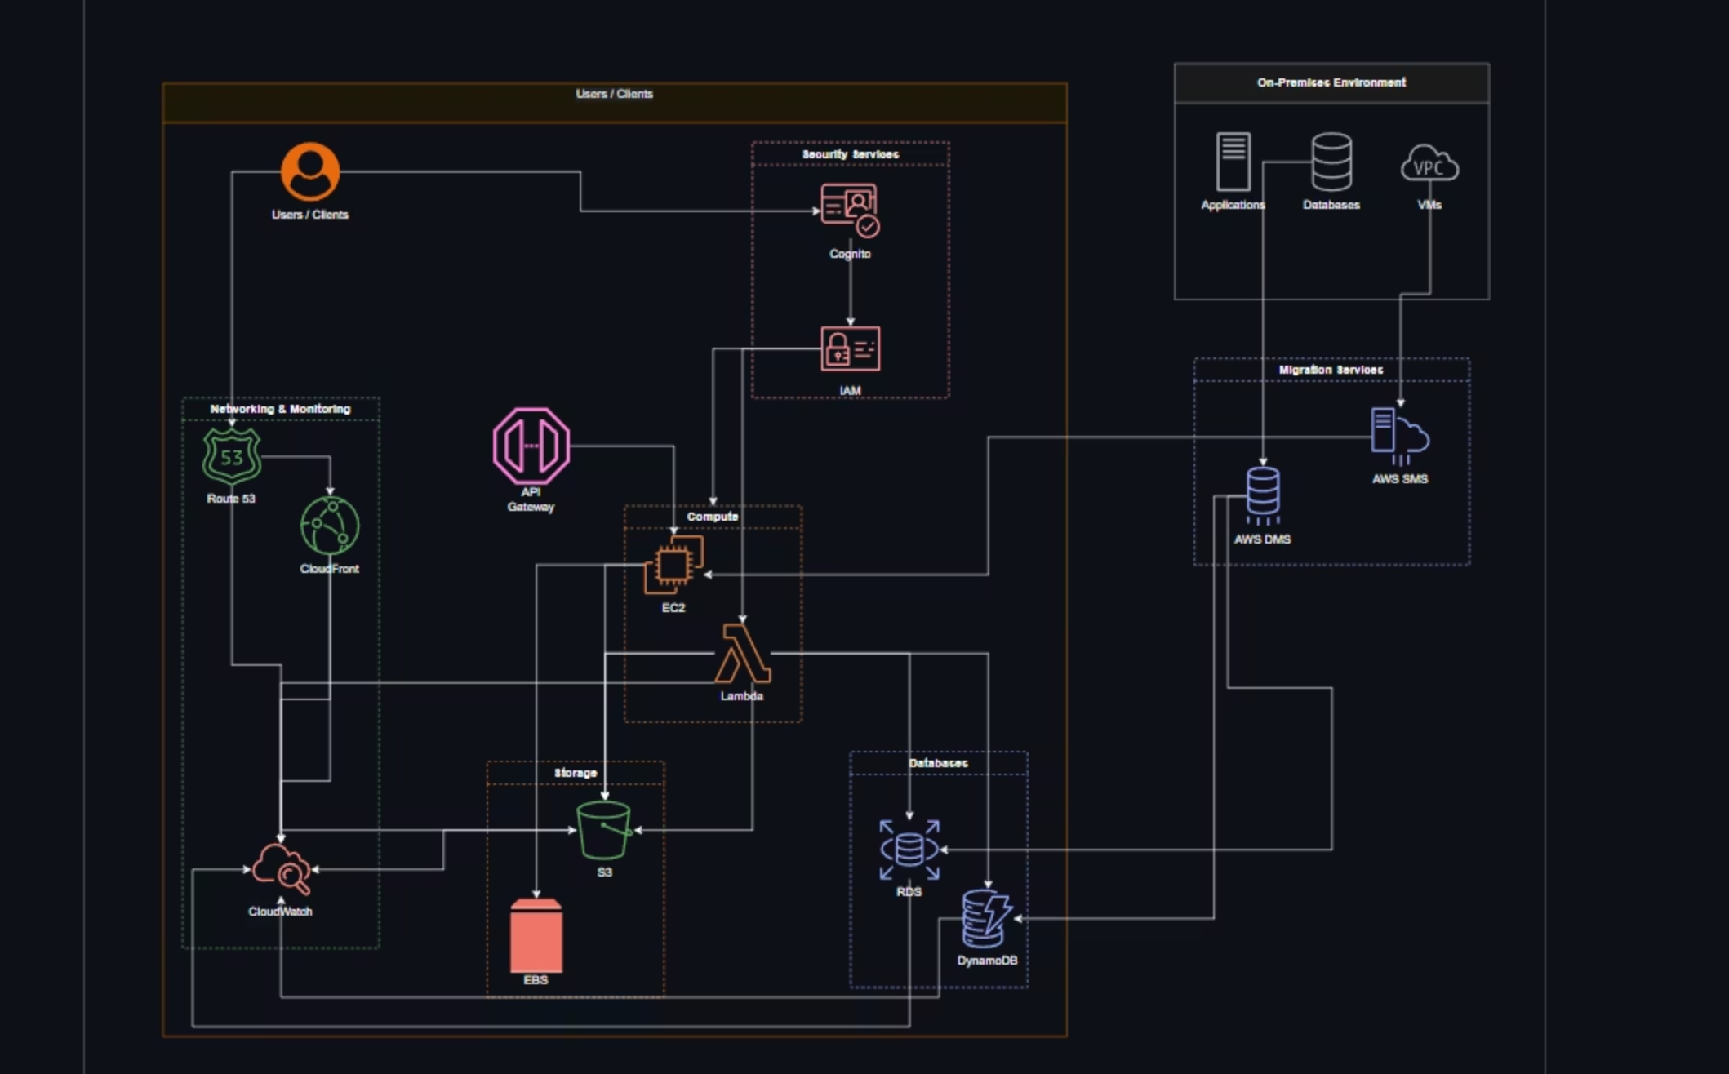
AWS Architecture for FreshlyGround Cafe
This diagram illustrates the complete migration and operational architecture for FreshlyGround Cafe's AWS infrastructure, detailing how on-premises resources transition to a scalable, secure, and cost-effective cloud environment.
Visit Live Site: cafena.com

Slide 11

Ready for the Future
Migrating from local cloud hosting to AWS delivers immediate cost savings, superior availability, and enhanced security—all while freeing you to focus on what matters: running your café.
$0
100%
0
Typical Monthly Cost
Uptime Target
Maintenance Hours
Built-in redundancy and recovery
Within AWS free tier limits
AWS manages infrastructure
Your architecture is now future-ready for additional branches, digital services, and business growth—without the complexity or costs of traditional hosting.

